Slide 1

Cost and Benefit Analysis
Co-Sub
Co-Sub
21102052 Lee Jeong-yun | 21102044 Oh Se-yeon | 21102050 Lee In-sun

Slide 2

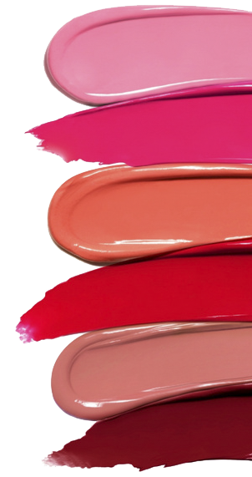
Contents
1
Item Identification
- Cost Item
- Benefit Item
- Estimated Income Statement
2
Estimation Process
- Cost & Revenue Estimation Logic
3
Cash Flow

Slide 3

Item Identification
1
Cost item
Purchase
M & O
Others

Slide 4

Item Identification
1
Cost item
Purchase
Why 8?
- Quarter subscription fee
- Eight delivery per year
(per year)
Lip product (lip product unit price * User * 8)
Average prices from our investigate in Olive Young, Hwahae, Zamface = ₩ 11,118.25 per product
Olive Young’s commission ratio = 45% (http://theviewers.co.kr/View.aspx?No=1628494)
8 products per year, then total price = ₩ 11,118.25 * 8 = ₩ 88,946
Sum vendor take = ₩88,946 * (1 – 45%) = ₩ 48,920.3
‘Cosub’ need to pay more than Olive Young to vendors to have advantages!
So, we decided to pay them ₩ 50,000 per a year, ₩ 6,250 per product.
cf) slide #12

Slide 5

Item Identification
1
Cost item
Purchase
(per year)
Package material (Package unit price * User * 8)
* Package unit price = ₩ 217

Slide 6



Item Identification
1
Cost item
M & O
(per year)
Hardware (MacPro + Pro display sdr + nas storage)
= 788,770,000+52,400,000
=841,170,000
Data (Tip of personal color expert + provider )
=(10,000 + 10,000) * 50,000
= 1,000,000,000

Slide 7



Item Identification
1
Cost item
M & O
(per year)
Facility (Deposit 25,000,000, Monthly rent 21,000,000)
* Gangnam-gu, Seoul
Delivery charge (2,500 * User * 8)

Slide 8



Item Identification
1
Cost item
Developer 4 person
M & O
(per year)
Manager 2 person
Salaries (60,000,000 * 6 person) = 360,000,000
Marketing Cost (Total of commission from vendor * 0.2)

Slide 9

Item Identification
1
Cost item
가격 계산기 | Microsoft Azure
M & O
(per year)
SW Operating (Virtual machine, Database, App service, Git )
Virtual Machine | 219,693
Azure SQL Database | 537,059
App Service | 78,837
Git | 166,608
Total(Month) | 1,002,197
Total (year)
: 12,026,364

Slide 10
Item Identification
1
Cost item
Others
(per year)
* NH Bank : 5.28%
Interest (Debt * Debt interest rate)
Internet, Electricity = 200,000 + 300,000 = 500,000
Tax (Taxible income * Progressive tax rate)
( * Taxible income = GI – OE – D )

Slide 11
Item Identification
1
Benefit Item
Vendor Commission
Subscription Fee

Slide 12


Item Identification
1
Benefit Item
Vendor Commission
(per year)
Subscription Fee - Delivery Fee – Packaging - Purchasing product

Slide 13
Item Identification
1
Benefit Item
Vendor Commission
(per year)
Cosmetics price from vendor | ₩ 50,000
Delivery cost (twice in a quarter) | ₩ (2,500 * 8) = 10,000
Package cost | ₩ (217 * 8) = 1,736
Subscription fee per quarter | ₩ 17,500
Subscription fee per year | ₩ (17,500 * 4) = 70000
Cosub profit | ₩ 8264 = (70,000 – 50,000 – 10,000 –1736)
Cosub profit ratio | 8264 / 70,000 = 11.80%

Slide 14
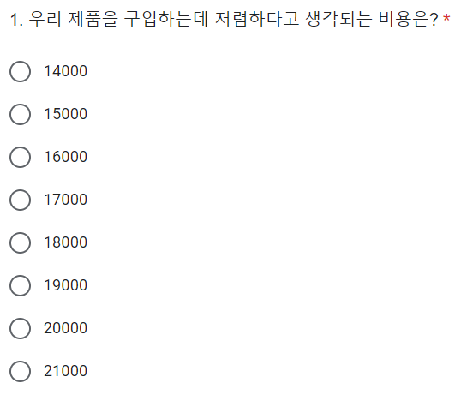
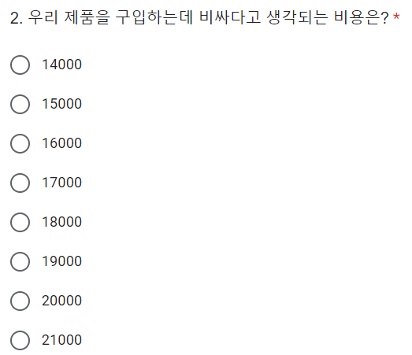
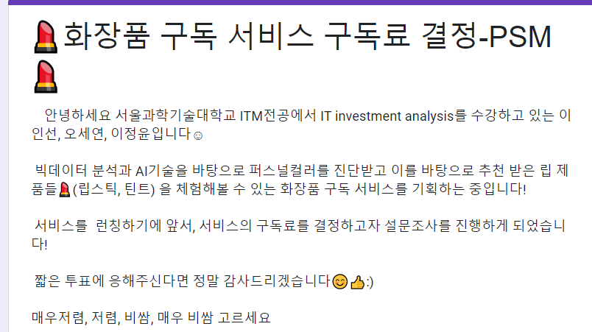
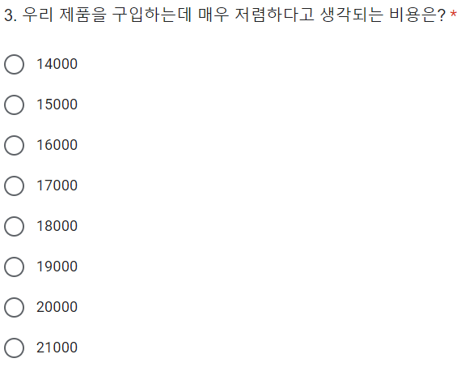
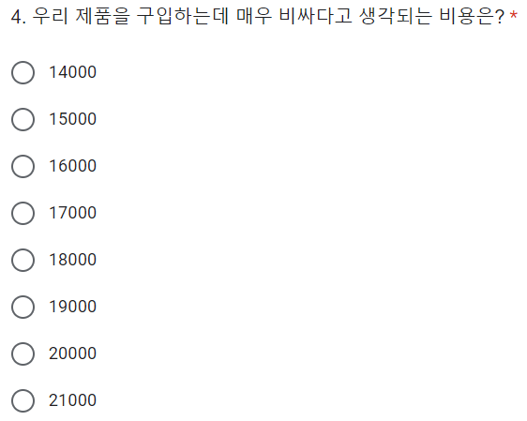
Item Identification
1
Benefit Item
< Subscription Fee >
* PSM method

Slide 15
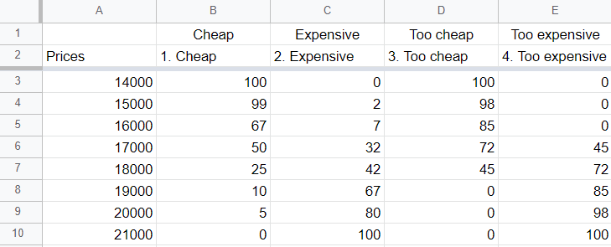
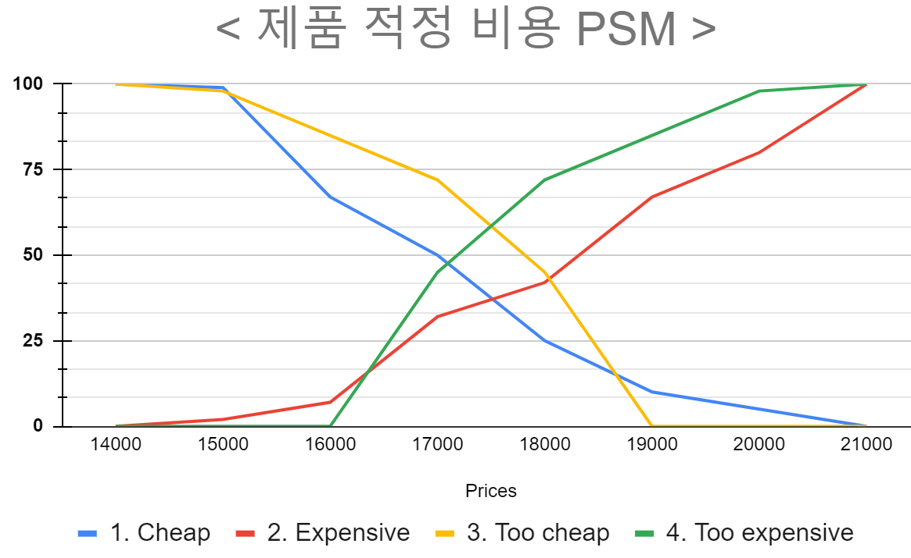
Item Identification
1
< Subscription Fee >
17,500

Slide 16
Item Identification
1
IT Performance Framework
New contract and renewal ratio of partners
Increase user repurchase rate
Self-development Support System Investment Capacity
Effectiveness
Assets management of ROI
Conversion
rate
Increment of business profit
Efficiency
Purchase cost reduction
Expanding market share in Cosmetics Sales
Increase
productivity
Sales growth rate
Operating profit growth rate
Quantitative
finance
customer
Internal process
Learning &
Growth

Slide 17
Item Identification
1
IT Performance Framework
Expand
user
selection
Employee work
experience
satisfaction
Effectiveness
Packing and
shipping satisfaction
The period
of update
Efficiency
Accuracy of community feed recommendations
Improved accuracy of personal-color diagnosis
qualitative
finance
customer
Internal process
Learning &
Growth

Slide 18
Item Identification
1
Estimated Income Statement
▶ First cost ◀
iMac pro + pro display xdr | 788,770,000
Nas Storage | 52,400,000
deposit | 250,000,000
Data | 1,000,000,000
Total : 2,091,170,000

Slide 19
Item Identification
1
Estimated Income Statement
▶ Depreciation item ◀
year | 0 | 1 | 2 | 3 | 4 | 5 | 6 | 7 | 8 | 9 | 10
mac | ₩ 0 | ₩ 78,877,000.00 | ₩ 78,877,000.00 | ₩ 78,877,000.00 | ₩ 78,877,000.00 | ₩ 78,877,000.00 | ₩ 78,877,000.00 | ₩ 78,877,000.00 | ₩ 78,877,000.00 | ₩ 78,877,000.00 | ₩ 78,877,000.00
storage | ₩ 0 | ₩ 5,240,000.00 | ₩ 5,240,000.00 | ₩ 5,240,000.00 | ₩ 5,240,000.00 | ₩ 5,240,000.00 | ₩ 5,240,000.00 | ₩ 5,240,000.00 | ₩ 5,240,000.00 | ₩ 5,240,000.00 | ₩ 5,240,000.00
Total | ₩ 0 | ₩ 84,117,000.00 | ₩ 84,117,000.00 | ₩ 84,117,000.00 | ₩ 84,117,000.00 | ₩ 84,117,000.00 | ₩ 84,117,000.00 | ₩ 84,117,000.00 | ₩ 84,117,000.00 | ₩ 84,117,000.00 | ₩ 84,117,000.00
Using Straight Line method
Period : 10 year

Slide 20
Item Identification
1
Estimated Income Statement
▶ Debt ◀
First cost | 2,091,170,000
Rate | 5.28%
Year | 10 year
Repayment period | 1 year

Slide 21
Item Identification
1
Estimated Income Statement
▶ Growth rate - Subscribers ◀
▶ Why the number of subscribers is 629,191 in year 6?
N = Percentage of people who have Not received personal color diagnostic experience
F = Percentage of people who have Failed to experience buy cosmetic in online shop
A = Number of downloads of Amore Pacific application in 2021
N ✕F ✕A = 629,191
▶Why did we refer to AmorePacific's number of downloads?
: AmorePacific is the company that has the largest share of the cosmetics market
▶ Except for six years, the number of subscribers in other years reflected Cosub's growth rate.

Slide 22
Item Identification
1
N
F
Q2. 온라인에서 색조 화장품을 구매했을때,
예상과 다른 색상을 구입한 적이 있으신가요?
(ex : 예상한 것보다 채도가 더 낮았던 경험, 사진으로 본 것보다 매트한 촉감이었던 경험, 기대한 것 이상으로 밝은 색이었던 경험 등)
Q1. 퍼스널 컬러를 진단 받아본 경험이 있나요?

Slide 23
Item Identification
1
▶ Growth rate - affiliated cosmetics company ◀
▶ Number of affiliated cosmetics company in Year 0
: 500
▶ Why is the growth rate of cosmetics companies affiliated with COSUB decreasing from the 6th year?
: Because it is close to 4,750,
the largest number of cosmetics companies affiliated with COSUB.
▶ Why is the maximum number of affiliated cosmetics companies
4,750?
: The total number of brands in Olive Young is 4,750.

Slide 24
Item Identification
1
▶ Growth rate - affiliated cosmetics company ◀
▶ Why is the number of brands of cosmetics in Olive Young based on?
: Because Olive Young is the company that occupies the largest share
of the cosmetics brokerage industry.
▶ Except for 0 year, the number of affiliated cosmetics company
in other years reflected Cosub's growth rate.

Slide 25
Item Identification
1
Estimated Income Statement
▶ Number of User ◀

Slide 26
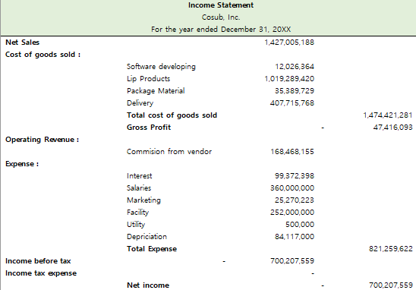
Item Identification
1
Estimated Income Statement
Year 2

Slide 27
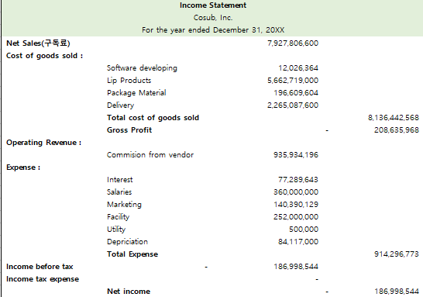
Item Identification
1
Estimated Income Statement
Year 4

Slide 28
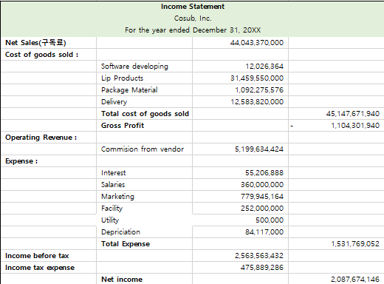
Item Identification
1
Estimated Income Statement
Year 6

Slide 29
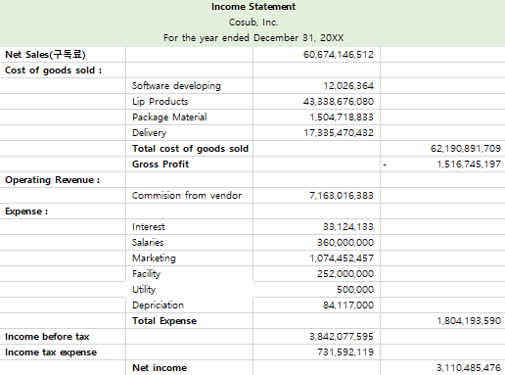
Item Identification
1
Estimated Income Statement
Year 8

Slide 30
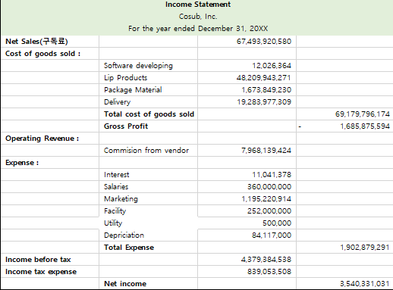
Item Identification
1
Estimated Income Statement
Year 10

Slide 31

Cash Flow
3
Cash In & Out Flow

Slide 32
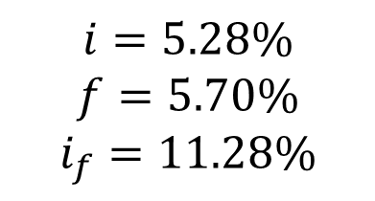
Cash Flow
3
Net Cash Flow, NPV
NPV
= ₩2,40,664,650
$$i=5.28\%$$
$$f=5.70\%$$
$$i_{f}=11.28\%$$

Slide 33
Cash Flow
3
B/C Ratio, IRR
NPV (Net present value) | ₩2,340,664,650
First Cost | ₩2,091,170,000
B/C Ratio | NPV / first cost = 1.119
IRR | 18%
> 1
> 10%
Cosub has good profitability
It satisfied with our goal IRR

Slide 34
Thank you
Co-Sub
Co-Sub
21102052 Lee Jeong-yun | 21102044 Oh Se-yeon | 21102050 Lee In-sun

